Slide 2
HEFMA Conference Oct 2021 Turning challenges into opportunities in the Higher Education sector by reskilling and upskilling FM staff (for the future)
AUDE presentation: Creating the leaders of tomorrow: A UK example of talent development

Slide 3
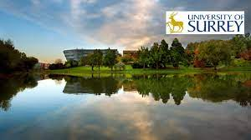
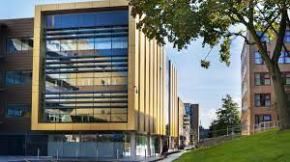
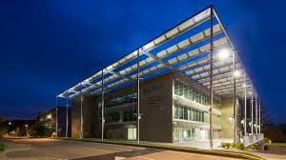
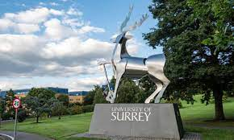
Stephen Wells AUDE Chair 2019 – 2021 Director of Estates, Facilities and Commercial Services, University of Surrey

Slide 4
A little bit about AUDE (Association of University Director of Estates)
AUDE works in collaboration with estates and facilities management professionals at universities throughout the UK and overseas.
Our service is diverse, providing the opportunity for members to share knowledge and access the support they need to address industry issues, and meet the individual and universal objectives which are specific to the higher education sector.
With a membership network spanning every UK university and an emerging presence overseas, AUDE’s is a unique voice for the professional estates and facilities community.
We provide strategic support on relevant issues such as sustainability, student experience, space planning and more – and we do this through association: with our members, with industry, with government, and with the wider community.
Through successful collaboration we facilitate the conversations, networking and discussion that provides solutions to the sector’s challenges.
Our scope is continually broadening, reflecting the ever-changing higher education landscape and the opportunities it presents.
Though our history as AUDE (the Association of University Directors of Estates) is as a membership organisation for senior leaders in higher education estates, increasingly AUDE acts to support everyone in estates and facilities teams in our universities.

Slide 5
Creating the leaders of tomorrow
Our Summer School residential programme has been running since 2018
Residential Programme
This 4 day and 4 night programme aims to nurture emerging talent in higher education estates and facilities management. Delegates hear from current estates directors and sector experts on key topical areas of estates and facilities management. In the evenings prominent business leaders and CEO’s are invited to give dinner speeches to the cohort.
This residential is a year long programme and commitment, the learning will not stop after the course has finished. The residential will provide a network of peers to strike up a working relationship with, which for many will be sustained for many years into the future.
Summer School will work best if its impact has longevity, so post-event there is a written assignment, which will consist of the groups summer school highlights (c.1,200 words). The groups will then follow this paper up with a written outline of their group project surrounding a working title provided at the residential (c.3000 words).
To finish off the programme there is an 'alumni' get-together and group presentations around 6 - 8 months after the residential to ensure learning has been put into practice. The project group shown to be the most impactful is invited to present at AUDE's conference in 2022.

Slide 6
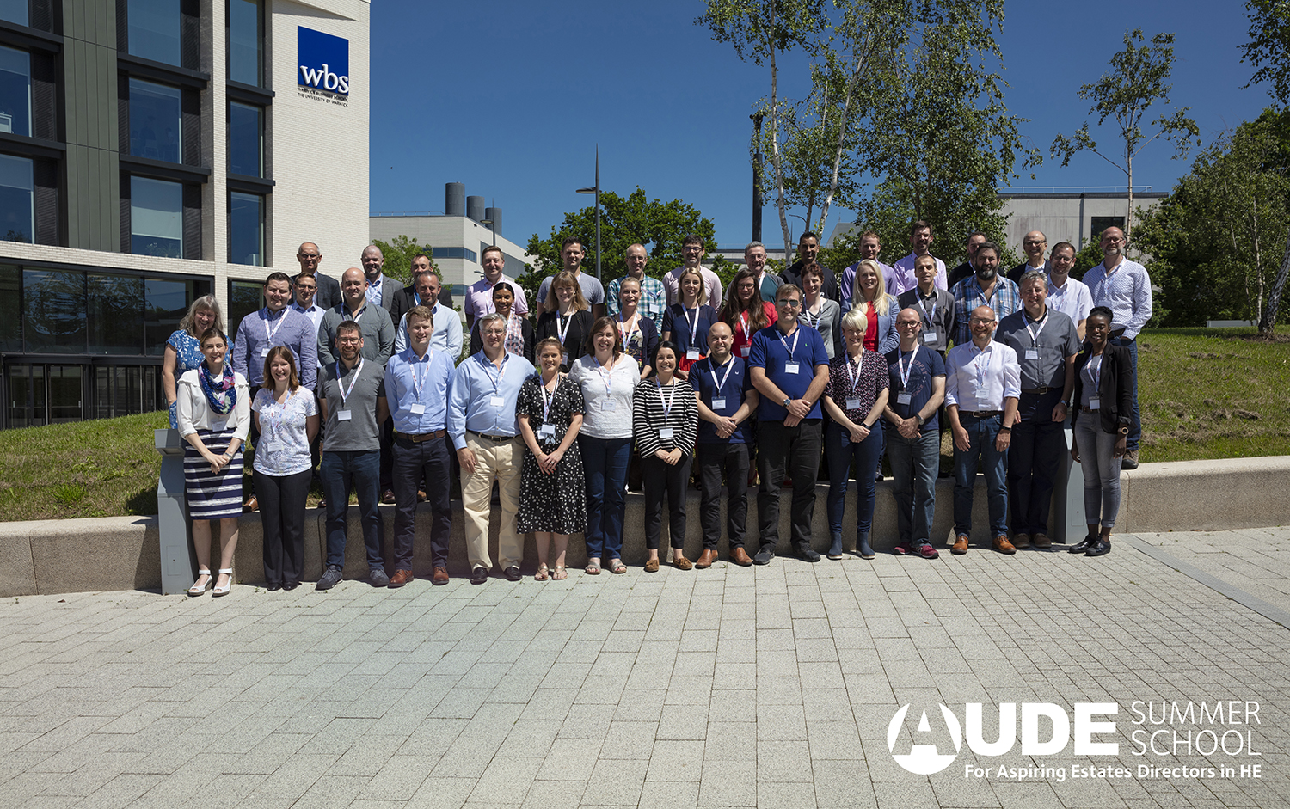
Who does the residential suit?
Members of Higher Education estates and facilities who are on their way to a career as a deputy director or director of estates and Facilities Management.
Individuals with the potential to grow from perhaps a generic or more junior role.
More senior professionals within a niche role who wish to expand their breadth of knowledge.
Example roles suitable for this course might include; projects portfolio manager, associate director, head of estate management etc.
We would recommend delegates have a solid understanding of the sector and matters affecting estates and facilities management professionals.

Slide 7
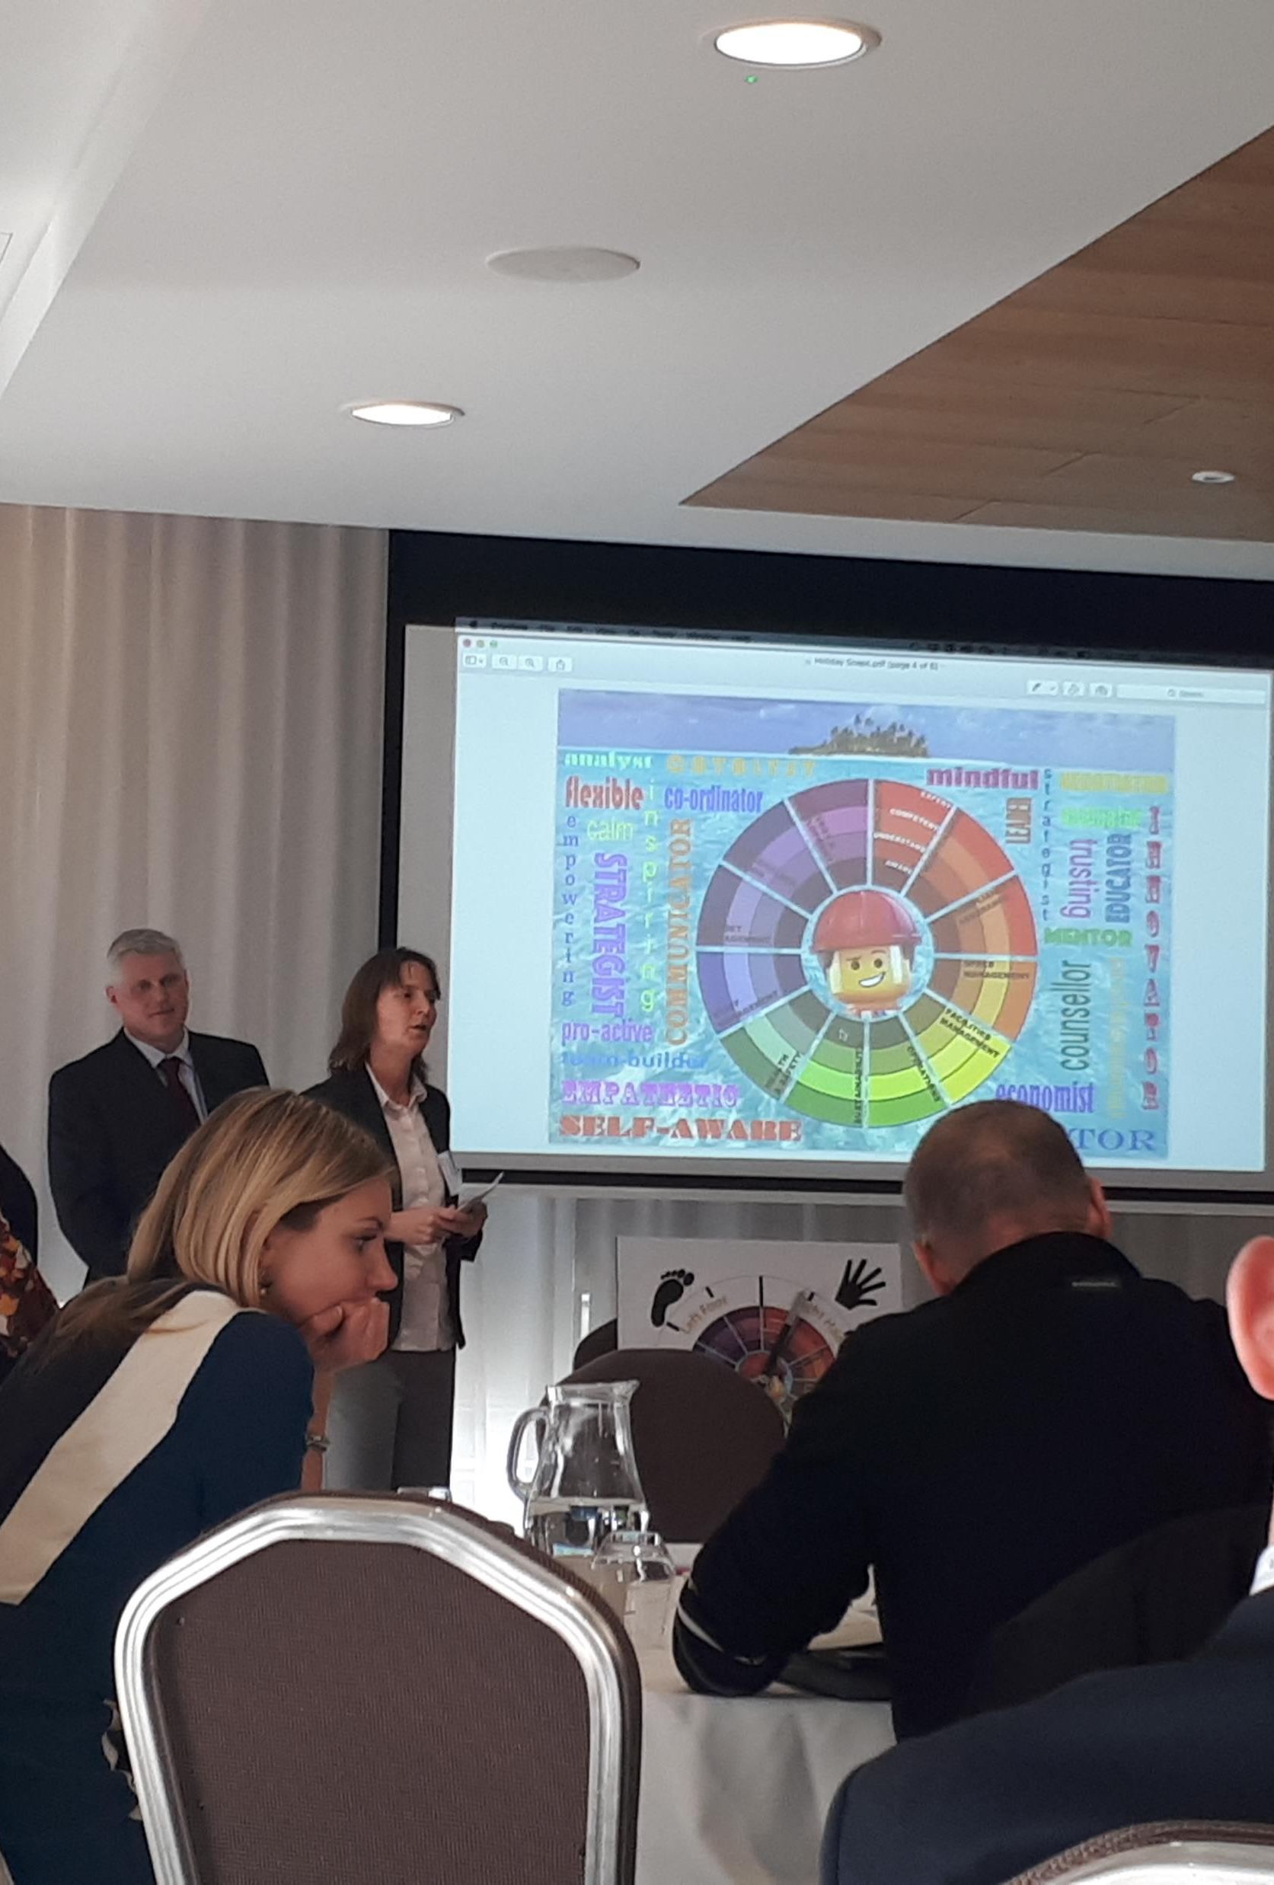
What skills and learning to expect from the residential?
Understanding the specifics of EFM in HE
Opportunity to build networks
Get up-to-date on current thinking, practice & case studies
Gain exposure to significant high-profile figures in HE
Learn new skills and methods for application
Proactive and practical learning
Influencing and leadership skills
Effective communication and stakeholder management
Strategic thinking.

Slide 8
Does it work?
From the 2 cohorts we have seen in 2018 and 2019 we have been informed about 14 promotions. That’s a rate of 20% promoted within 12 months of completing the course.
A recent graduate and one of those recently promoted, told us………
“There are huge benefits to attending Summer School,” Jack said. “But for me the two standout items were confidence development and the network.
“It was a real test for me. Sitting in those sessions with peers from across the country, and with international delegates too, could I hold my own in that environment? Did I feel comfortable, and could I engage at the right level on the detail, the technical and the strategic? Was I confident that I was in the right place, and did it feel like my career aspirations were realistic? To come away from such an intense programme and feel that the answer was ‘Yes’ was a huge confidence boost. The entire cohort were engaging and supportive and I feel I learnt just as much from each of them as from the structured speakers.”

Slide 9
Why does it work?
It works because of the quality of the professional facilitator who links every session and every day of the programme, keeping the participants focused on their project work.
Great speakers, well briefed, all sessions are an hour long and interactive.
Senior industry speakers invited as after dinner speakers.
The course is residential and full on, no time to slip back into work emails.
Depth breadth of the content including for example; Don Guckert the Chair of APPA, our American counterpart.
International delegates pre-covid, including University of Cape Town, University of the Free State and University of Pretoria.
This is a long-term programme we follow the delegates for a year.
Sense of competition, between participants as there are prizes and accolades for winning project groups.
We listen to their project outputs and put them into practice. AUDE recently launched a work shadowing programme on the recommendation of one of our project groups.

Slide 10
Reflection as chair of AUDE
Succession planning and investing in talent…
My professional Journey..
Formal training funded by my employer
Staff feel valued when you invest in them
Learning and professional development
Grow your own
Promoting within your own department or organisation
Doesn’t only work with managers.

Slide 11
Video

Slide 12
Thank you

Slide 13
AUDE
(The Association of University Directors of Estates)
3 Holywell Drive
Loughborough University
Loughborough
Leicestershire LE11 3TU
www.aude.ac.uk
info@aude.ac.uk
Twitter: @AUDE_news
LinkedIn: AUDE_news

